Slide 1
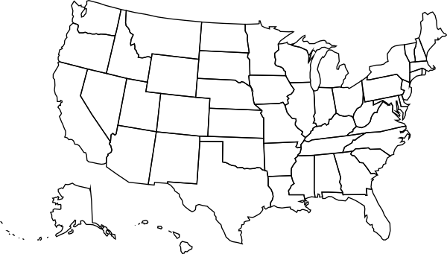
Opportunity: U.S. Energy Capacity growth
Current U.S. Plant Capacity
1,181,363MW
Planned U.S. Plant Capacity
112,345MW
+30
million
over next 10 years
Source: US Energy Information Administration, EIA.gov

